Slide 1

Population dynamics in the USA
Report

Slide 2

An Overview of Population Growth and its Impact
The given dataset consists of population representing for each state per year between 2013-2020. I have selected a few states which had significant changes in population from 2013 to 2020.
And presented them in the chart below in graphical form for keen understanding.
Coming to Population dynamics, this data shows change in population over the years especially with regards to steady imbalances, will have significant effect on advancement processes and on the comprehensive and adjusted development and results in the next few decades. They likewise challenge the limit of nations to accomplish wide based improvement objectives. Therefore, this data collection helps further for the different states for better growth and facilities.

Slide 3
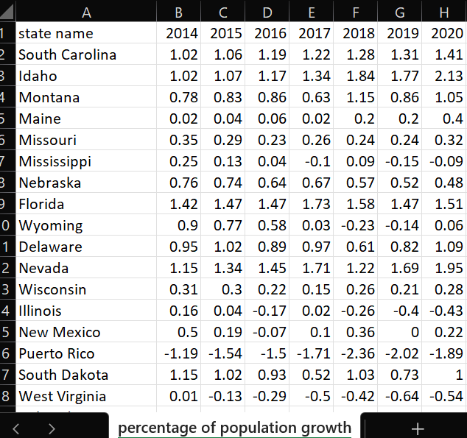
Graphical Representation of findings from the given data over the years

Slide 4
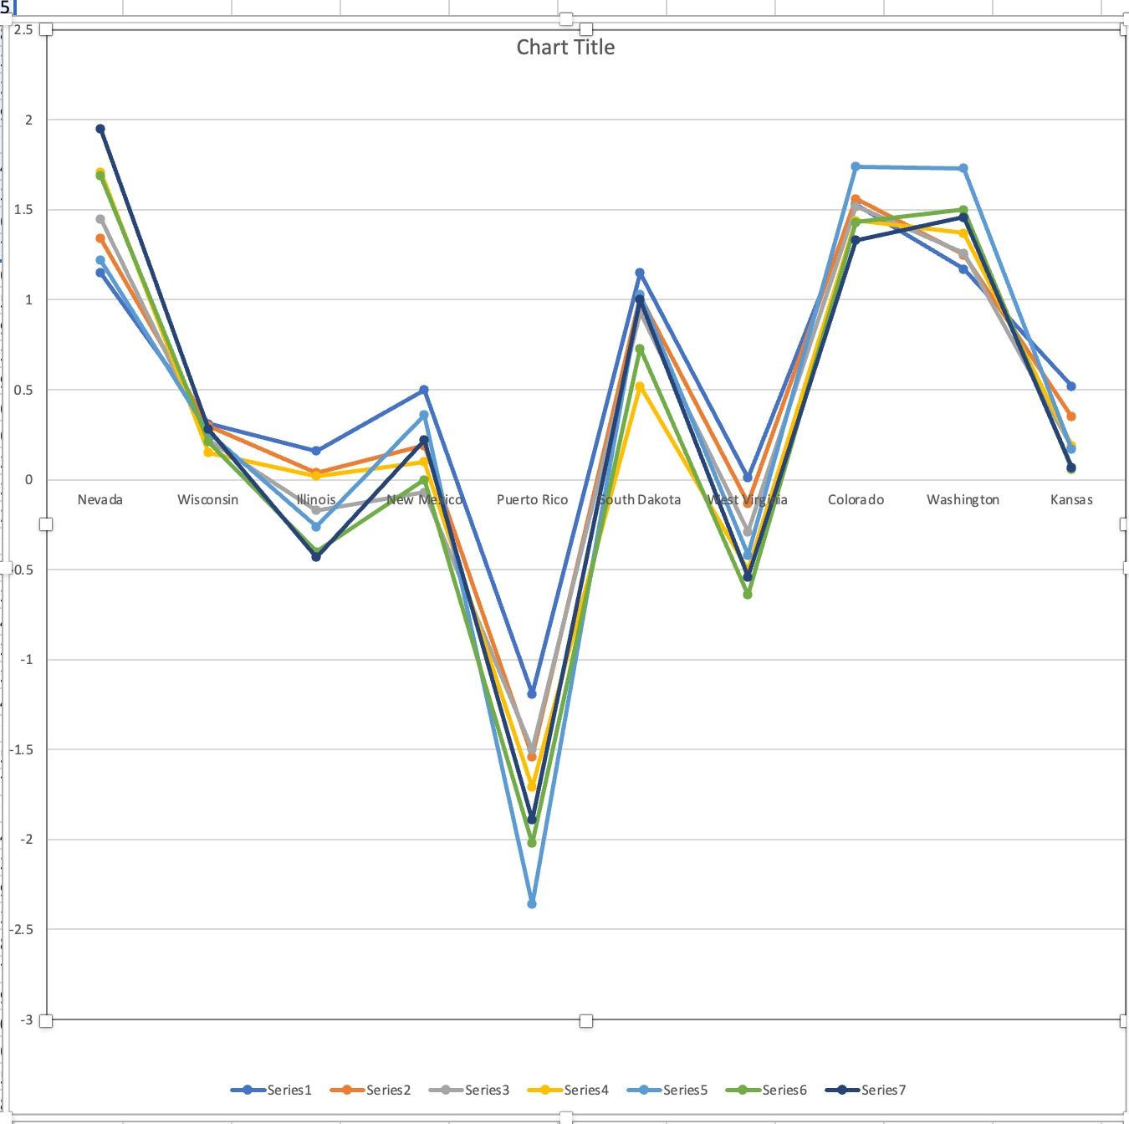
Figure 1:Representation of population change over years 2013-2020 in percent.

Slide 5
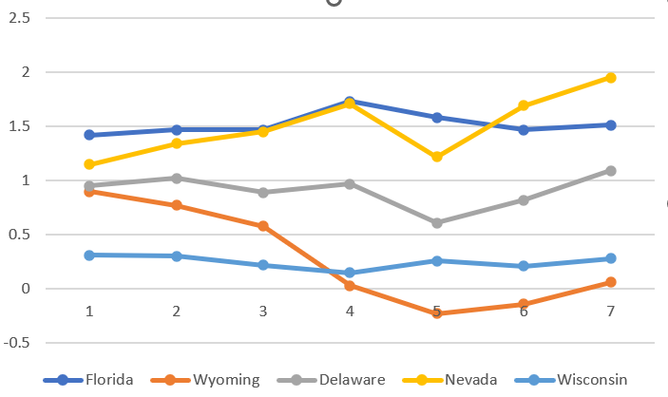
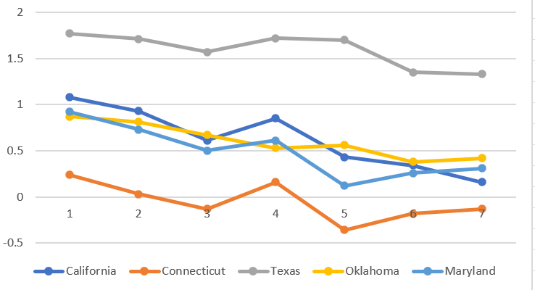
Comparison between different states in Population Growth Change
Figure 2: five states population change from 2014-2020
Figure 3:other set of five states population change from 2014-2020

Slide 6
Explanation from above representation
Based on the above graphical representation referring to figure 2, it is obvious that the state of Florida population has seen constant in years 2014-2016 and there was sudden increase in population in 2017 and there was gradual downfall in population growth from years 2018-2020.
Whereas the population in Wyoming has been continuously decreasing from years 2014-2019 and slight increase in the year 2020. Coming to Delaware, the population growth rate has a subtle rise and fall over the years alternately from 2014-2020.
Meanwhile, in Nevada the population has been increasing over the years 2014-2017 but there was sudden decline in 2018 due to various reasons though it started to increase from 2019 again. Wisconsin’s population has been constant throughout the years from 2014-2020 except in 2017.
Referring to figure 3, taken the representation of other five states comparingly California, Connecticut and Maryland has downfall from years 2014- 2016 and a gradual increase in 2017 as seen. Yet again there was decrease in population growth from 2017-2020 as of above reasons mentioned.
The population growth of Texas was unbelievable, it has been constant almost over the years 2014-2018 and there was sudden downfall in the last two years. Apparently, Oklahoma’s population has been falling year by year over the period of 2014-2020.

Slide 7

Summary
Arizona has increased population growth mostly due to domestic migration. Most of the people from major cities of Coastal side are migrating to get exempted from higher taxes and looking for reasonable housing and better quality of life, whereas in contrast there was complete decrease in population in few states like Rhode Island and North Dakota, Louisiana, Alaska, Hawaii.
However, most of the US states has population growth decreased gradually over years 2014-2020 due to various factors like migration, unemployment and also due to late marriages and decrease in birth rates as presented in multiple articles and also pandemic situations has affected the population growth too leading to cause of a greater number of deaths from past two years.
Few states also has seen the growth in population in these years irrespective of different conditions such as South Carolina, Idaho.

